Slide 1


Generative AI in Aviation
By Sawan Chawla

Slide 2

Executive Summary
Generative AI as an emerging technology is powered by large language models that can generate extraordinary text, images, as well as other content based on the data it was provided and trained with.
The aviation industry finds itself at a crossroads as the applications of Generative AI are far reaching and has captured the imagination of many leaders worldwide.
Its implementation has the potential to revolutionize the industry in ways never seen before.

Slide 3
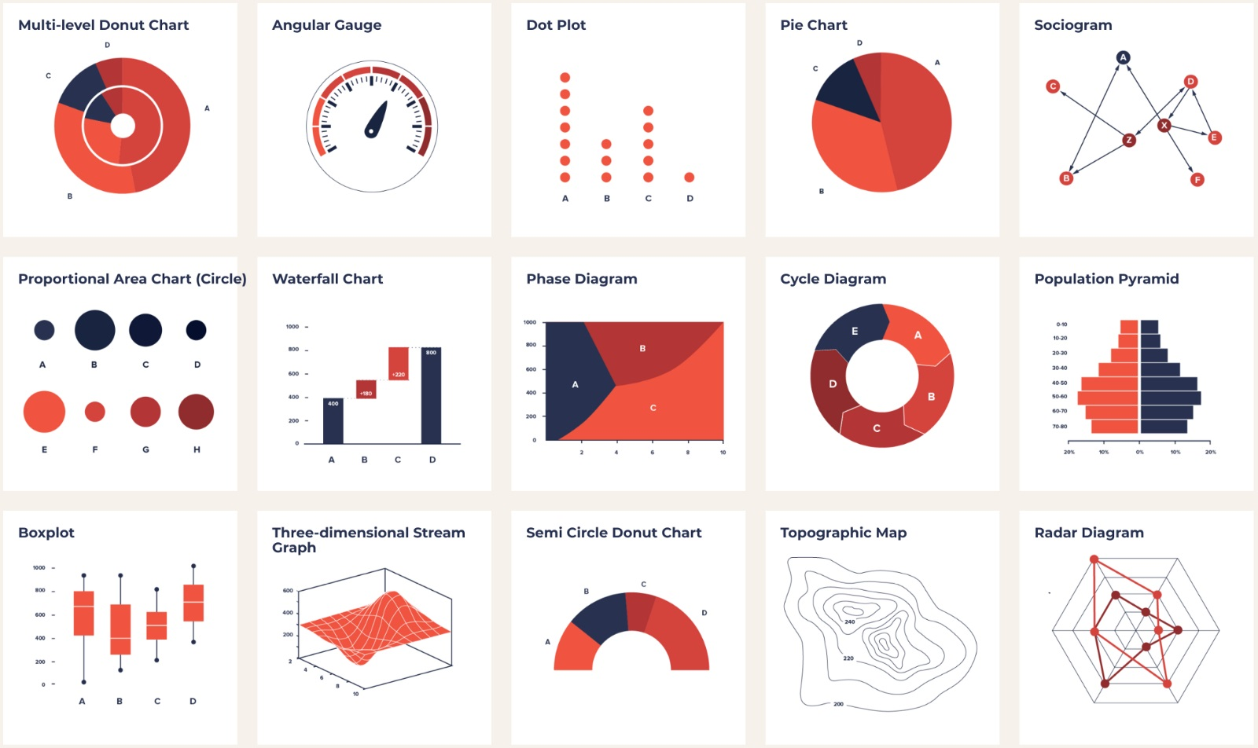

What is the Technology
Think of Generative AI as an incredibly smart assistant.
It learns patterns from huge amounts of data.
Then uses said data patterns to make content based on what it learned which is human-like.
This content is created by what we tell it to do.
Can assist you in wide ranging activities from coding software to writing memos to making reports and devising solutions to complicated problems on many subjects.
Various potential uses across many industries due to its capabilities.

Slide 4
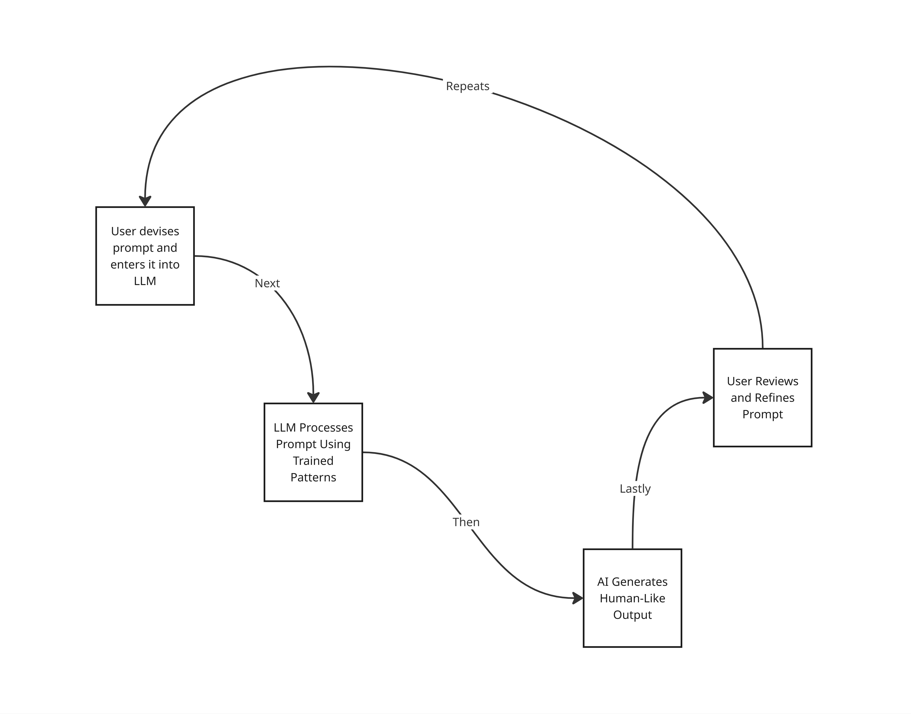
How it Works
User provides LLM with a prompt
AI provides response to prompt
Repeat until you get desired results
Currently in Aviation and in general, Generative AI is at the stage of early adoption.

Slide 5
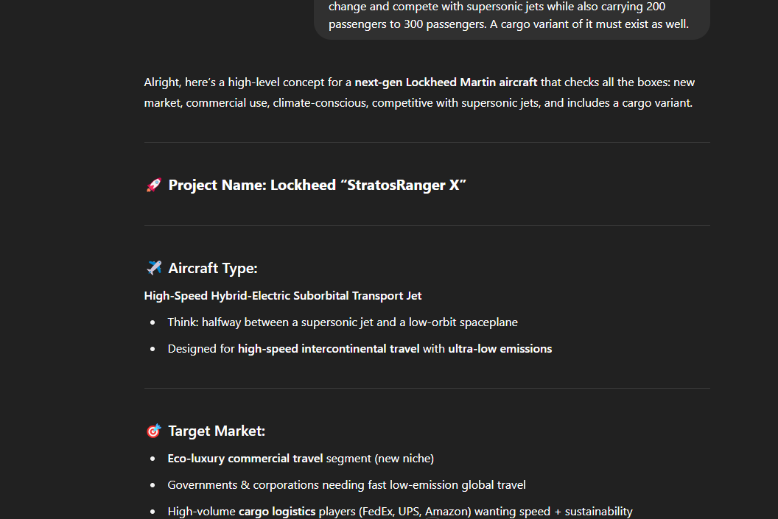
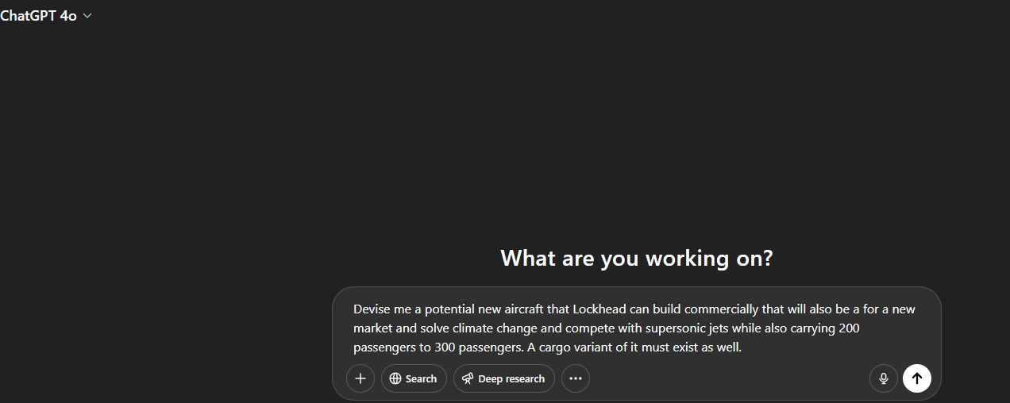
Real Life Example
Step 2:
Step 1:

Slide 6
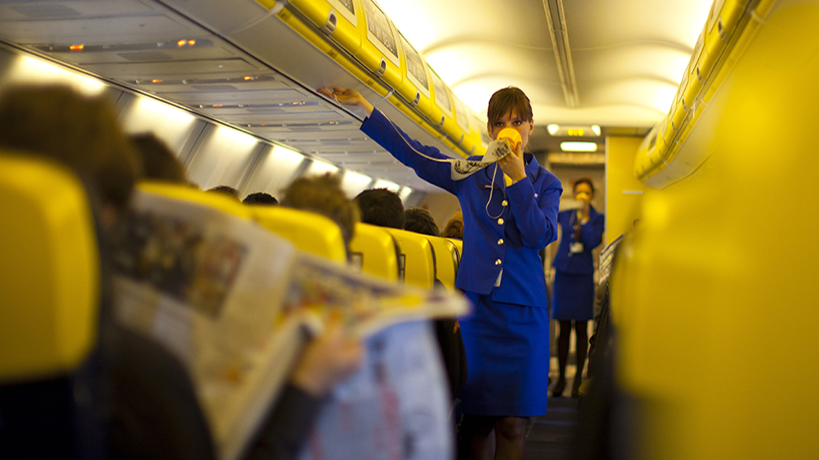
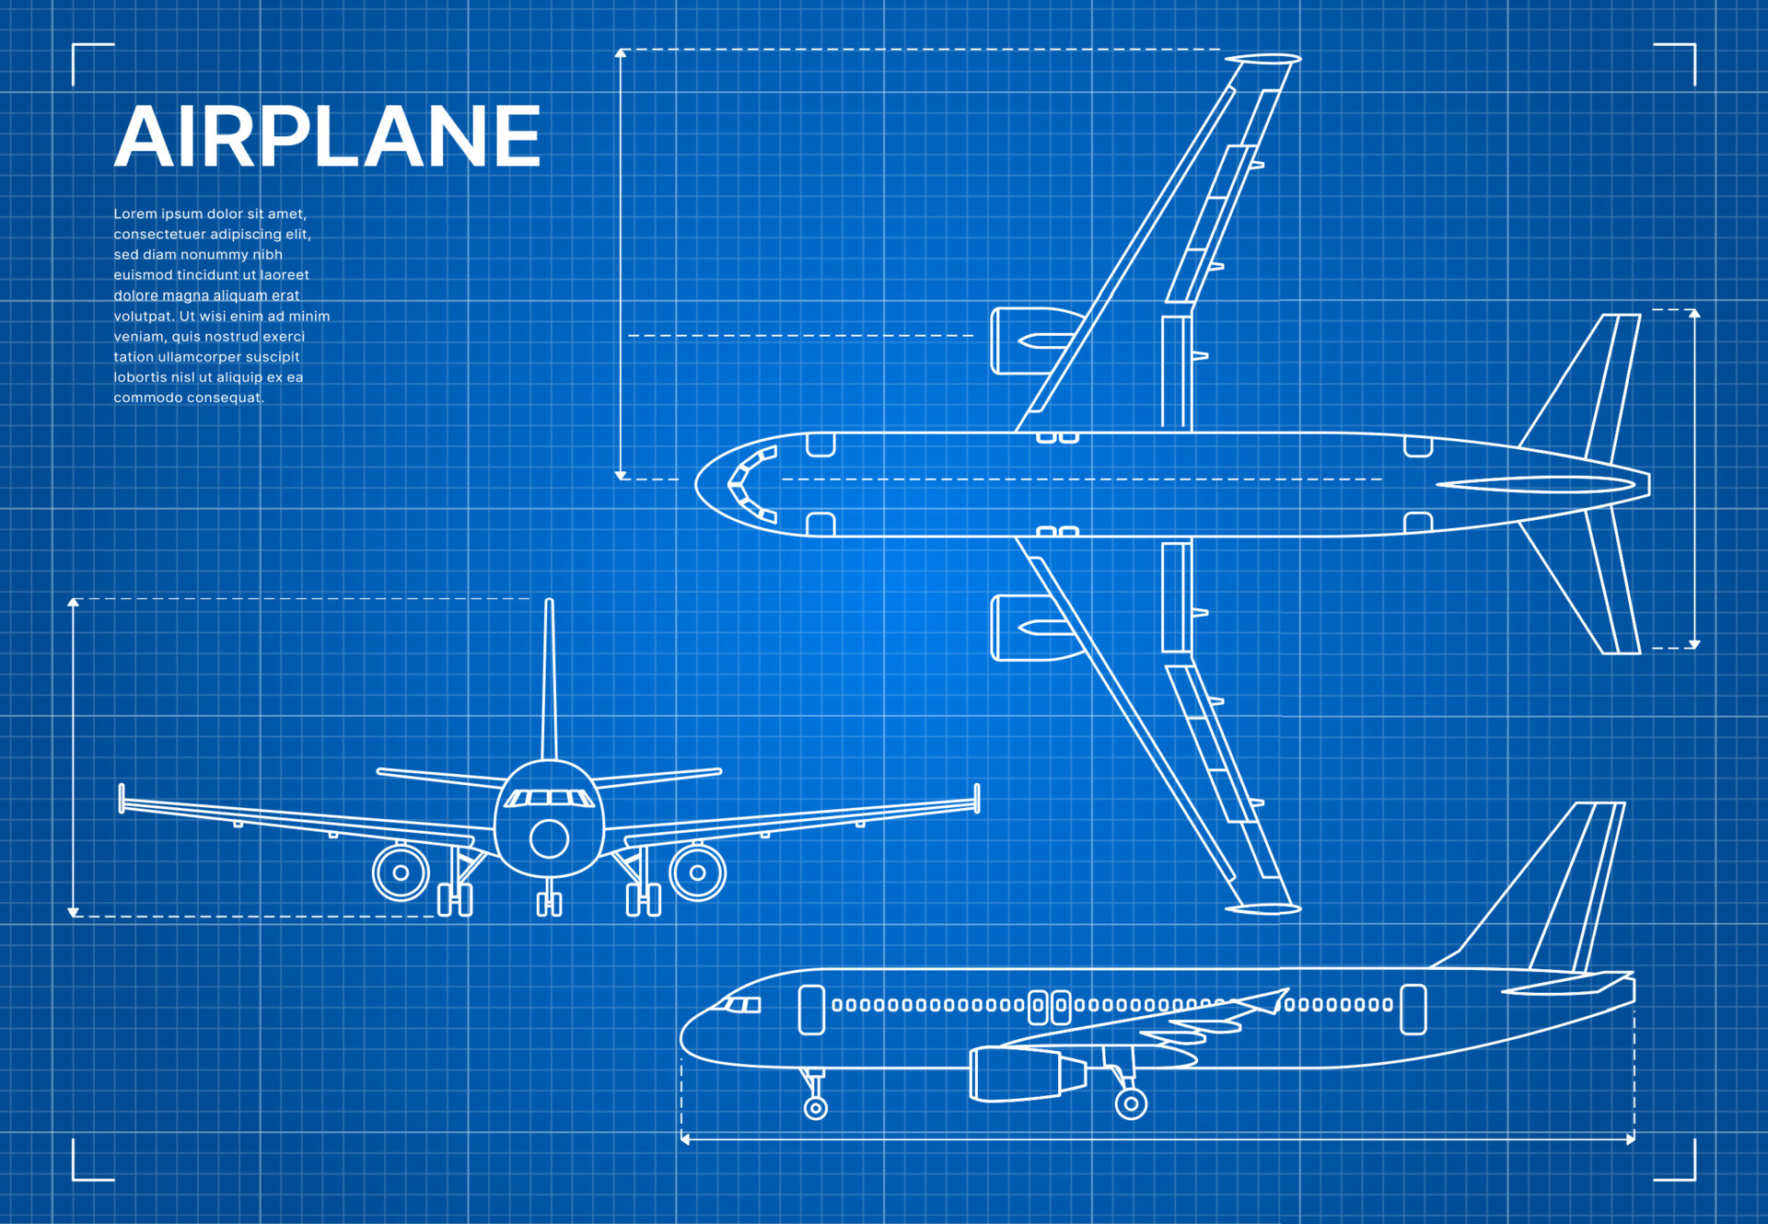

Applications
The applications of AI in aviation are wide. This includes the following:
1. Improvements to current and new aircraft designs in terms of efficiency as well as safety, design process such as automating tasks usually done by human labor to rapid prototyping plus digital testing.
2. Efficient allocation of crew, as well as timely scheduling of key profit-making routes in advance, and predictive maintenance schedules that allow aircrafts to be utilized to the max safety while simultaneously being efficient with schedules (almost like just in time production).
3. Understanding customer preferences, suggestions as well as recommending key changes while also solving common and rare issues in customer service.

Slide 7
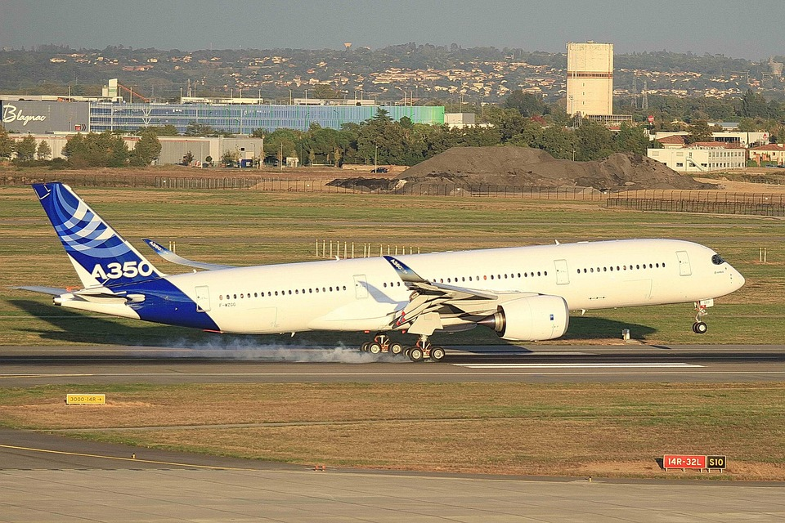

Case Study #1: Airbus
Airbus is looking to reinvent itself using Generative AI.
The company is currently testing Generative AI across various tasks but not deploying on a large scale.
Example of experimentation include management of complex documents, customer service post sales, assistant for standard operating procedures (SOP), providing instructions for manufacturing aircraft, and chatbot functionality.
While the technology is making headway, Airbus must navigate regulatory constraints, as well as ensure that the technological solutions generated by Generative AI are safe, responsible and ethical in nature.

Slide 8

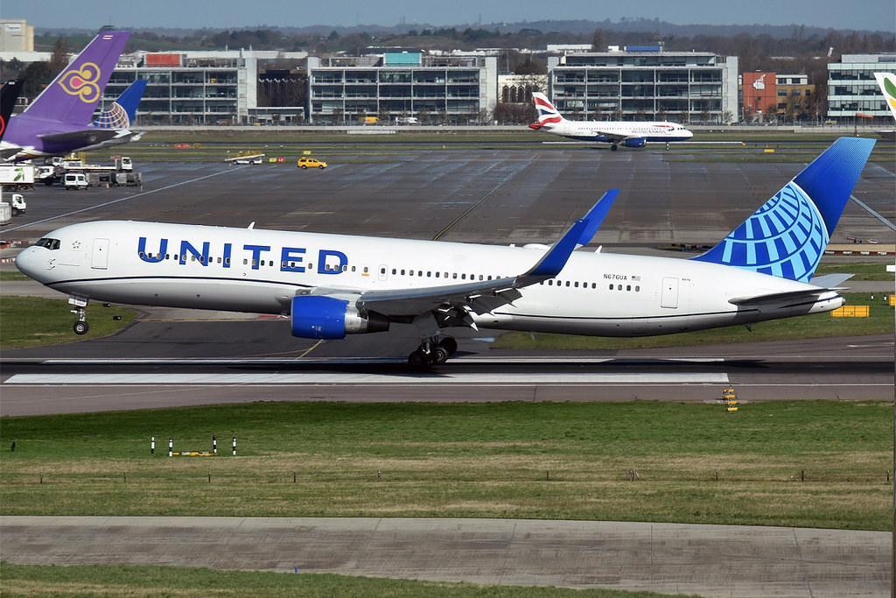
Case Study #2: United Airlines
United Airlines is using Generative AI to enhance customer experience and maintain process excellence.
To attain these goals, United is using its AI/ML platform, “Mars”, to automate digital notifications such as delay communications, and manual workload reductions for customer service agents.
Currently utilizes ChatGPT for secure employee use (experimental) and LLM for external users known as “Every Flight Has a Story.” Which utilizes the “Mars” platform.
So far, United Airlines has utilized the LLM to send out more than 100,000 notifications and has identified 90 other use cases for software.
Additionally, customer satisfaction improved by 6%

Slide 9



Impact Assessment
Has the potential to automate customer service by increasing customer satisfaction through fast addressing of customer service issues, offers as well as packages tailored towards customer preferences, proactive notifications of flight delays based of predictive analytics and optimized flight scheduling.
In terms of aircraft manufacturing, workloads to employees can be reduced by automation of tasks such as report generation or use of virtual assistant for product development as well as management, and virtual simulations of airframes to test viability plus customization of key parts to meet customer needs.
In terms of safety plus risk mitigation, can analyze data as well as predict potential safety concerns via real time analysis, improve pilot training and schedule maintenance concurrently with large gaps between scheduled departures.

Slide 10

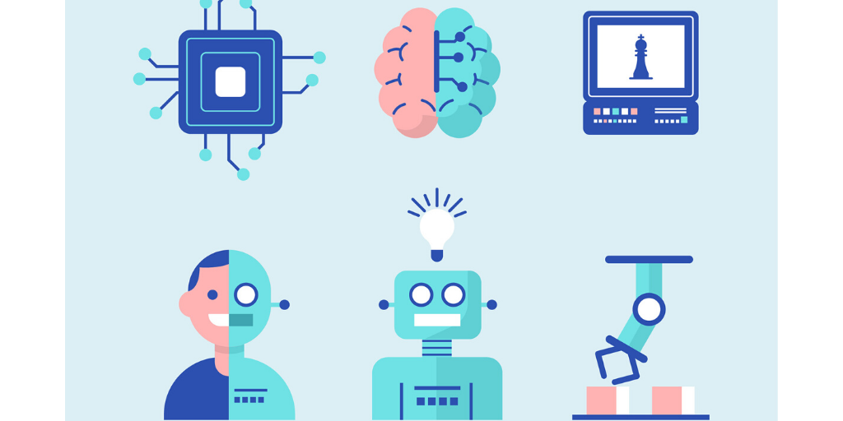
The Drawbacks
Generative AI relies on high-quality data, and this type of data is not available readily in the aviation industry due to data privacy concerns as well as the complexity of aircraft systems itself.
The challenges of integrating Generative AI into the fundamentals is very difficult due to the compositeness of the systems itself being in place for so long, as well as system criticalness in daily use, resulting in a very slow incorporation into the industry that can span years, especially with also the widespread extent of the architecture itself.
Ethical concerns and potential for hallucinations or inaccuracies is a major concern when integrating it.
Ethical concerns including data privacy, bias as well as job placement play a major role as data may not be safely stored while the AI may display biasness in certain situations and in addition causing potential job losses in certain areas of industry where there's shortages of key personal.
Hallucinations may result in incorrect information being displayed. Whether it is a in the flight computers of aircraft or in the systems of Air Traffic Control (ATC), hallucinations is something that cannot happen in this industry given its nature, as it sets a dangerous precedent if left unchecked.

Slide 11
Investment Recommendation
Invest slowly in Generative AI, as a rigorous training program would be expected before implementation in aviation, due to the nature of the industry and the compliance standards any new piece of technology is held to.
In terms of where to begin, do so with small basic tasks to automate, such as generating reports and recommendation of data, then expand to more complicated tasks like chatbots for customer service or predictive analytics for maintenance schedules as well as recommendations plus virtual simulations for new aircraft designs.
When it comes to budgets, start with a small budget (somewhere in the millions) and then keep adding more funding, the more return received in the form of cost cutting in terms of practices as well as process improvements, revenue increases via customer experience, improved reputation and lowered workload of employees, resulting in more productivity plus workplace moral.

Slide 12
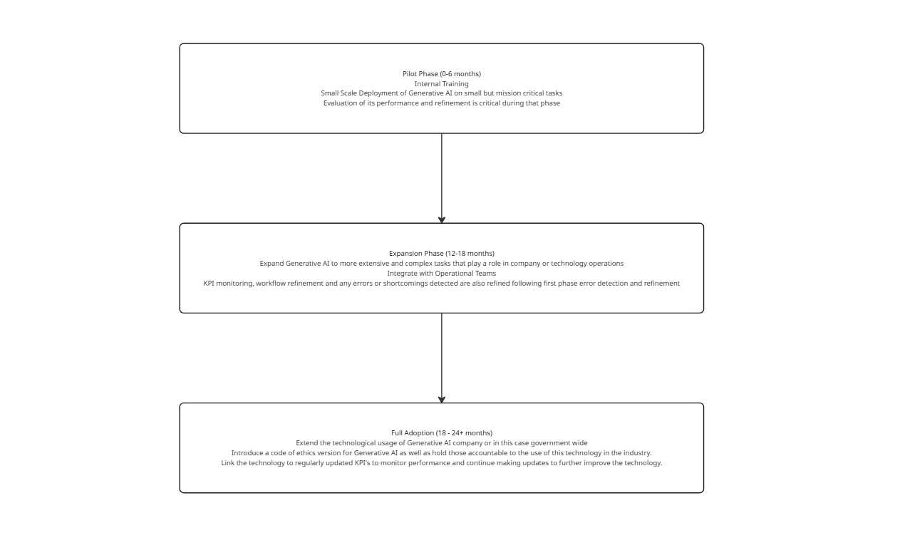
Roadmap

Slide 13
Sources
7. “How Airbus Uses Generative Artificial Intelligence to Reinvent Itself | Airbus.” Www.airbus.com, 28 May 2024, www.airbus.com/en/newsroom/stories/2024-05-how-airbus-uses-generative-artificial-intelligence-to-reinvent-itself.
“AI in Aviation and Airlines : Post Pandemic Reports and Key Findings.” MindTitan, 5 Jan. 2022, mindtitan.com/resources/industry-use-cases/ai-in-aviation-and-travel/.
Benelux, Cognizant. “From Assessment to Innovation: Your Gen AI Roadmap.” Www.cognizant.com, 2025, www.cognizant.com/nl/en/insights/blog/articles/rapid-generative-ai-assessment-tool. Accessed 22 Apr. 2025.

Slide 14
Sources
Bilan, Maryna. “How Generative AI Revolutionize the Aviation and Airlines Industry.” Master of Code Global, 23 June 2023, masterofcode.com/blog/generative-ai-chatbots-for-airline-and-airport-industry.
Brand, Amelia. “United Airlines Takes Flight with Generative AI United Airlines Is Charting New Territory with Gen AI Initiatives to Enhance Customer Experience and Operational Efficiency.” Process Excellence Network, 29 Dec. 2024, www.processexcellencenetwork.com/automation/news/united-airlines-takes-flight-with-generative-ai.
Brownlow, Jess. “The Challenges Generative AI Poses for the Industry.” Worldaviationfestival.com, 9 Mar. 2023, worldaviationfestival.com/blog/travel-technology/the-challenges-generative-ai-poses-for-the-industry/.

Slide 15
Sources
Burnham, Kristin . “What’s Your Company’s AI Maturity Level? | MIT Sloan.” MIT Sloan, 25 Feb. 2025, mitsloan.mit.edu/ideas-made-to-matter/whats-your-companys-ai-maturity-level. Accessed 22 Apr. 2025.
Cunnison, Martin. “7 Key Advantages of Generative AI for Airline Operations.” Ciklum.com, 15 Jan. 2024, www.ciklum.com/resources/blog/enhanced-ux-accessibility-to-recapture-90-percent-of-bounced-visitors, https://doi.org/108922090/1729238536003/module_99108922090_related-blog-post-section-2024.
“Generative AI Adoption Maturity Model.” Github.io, 2025, vikasgoyal.github.io/genai/AdoptionMaturityModel.html. Accessed 22 Apr. 2025.
“Generative AI Maturity Model.” EY, 2025, www.ey.com/en_it/insights/ai/generative-ai-maturity-model. Accessed 22 Apr. 2025.

Slide 16
Sources
“How AI Is Transforming the Aviation Industry.” Southern Wings, 28 Jan. 2024, www.southernwings.co.nz/how-ai-is-transforming-the-aviation-industry/.
IATA. Generative AI and Aviation Finding Crossroads for Future Implementation. 2023.
Lisowski, Edwin. “Top 5 Gen AI Use Cases in Aviation - Edwin Lisowski - Medium.” Medium, 27 Sept. 2024, medium.com/@elisowski/top-5-gen-ai-use-cases-in-aviation-20b62583dbfa.
Martineau, Kim. “What Is Generative AI?” IBM Research Blog, IBM, 20 Apr. 2023, research.ibm.com/blog/what-is-generative-AI.

Slide 17
Sources
McKone, Dan , et al. Deploying AI and Generative AI in the Airline Industry: Enhancing Operations and Improving Customer Experiences.
Nvidia. “What Is Generative AI?” NVIDIA, 2024, www.nvidia.com/en-us/glossary/generative-ai/.
Raval, Chintan. “Generative AI in the Aerospace Industry: A New Frontier of Innovation.” EInfochips, 20 Jan. 2025, www.einfochips.com/blog/generative-ai-in-the-aerospace-industry-a-new-frontier-of-innovation/.
Saboonchi, Behnaz. “How a Top-down Holistic Strategy Can Maximize GenAI ROI.” EY, 18 June 2024, www.ey.com/en_gl/insights/strategy/explore-the-five-levels-of-the-gen-ai-maturity-model. Accessed 22 Apr. 2025.

Slide 18
Sources
Schradin, Ryan. “How Generative AI Will Change the Commercial Aviation Industry.” Connected Aviation Today, 1 May 2024, connectedaviationtoday.com/how-generative-ai-will-change-the-commercial-aviation-industry/.
Team DigitalDefynd. “10 Ways Generative AI Is Being Used in Aviation [2025].” DigitalDefynd, digitaldefynd.com/IQ/generative-ai-in-aviation/.
Trevin Christian Casinader. “United Airlines’ Use of Generative AI Results in 6% Improvement in Overall Customer Satisfaction.” Simple Flying, 29 Dec. 2024, simpleflying.com/united-airlines-generative-ai-improvement-customer-satisfaction/.
“W3Schools.com.” W3schools.com, 2025, www.w3schools.com/gen_ai/. Accessed 22 Apr. 2025.

Slide 19
Sources
Waddell, Dee, and Steven Peterson. “How Generative AI Can Transform the Aviation Industry.” IBM, 4 Dec. 2023, www.ibm.com/think/topics/generative-ai-for-aviation.
Zewe, Adam. “Explained: Generative AI.” MIT News, Massachusetts Institute of Technology, 9 Nov. 2023, news.mit.edu/2023/explained-generative-ai-1109.

Slide 20
THANK YOU

